Slide 1
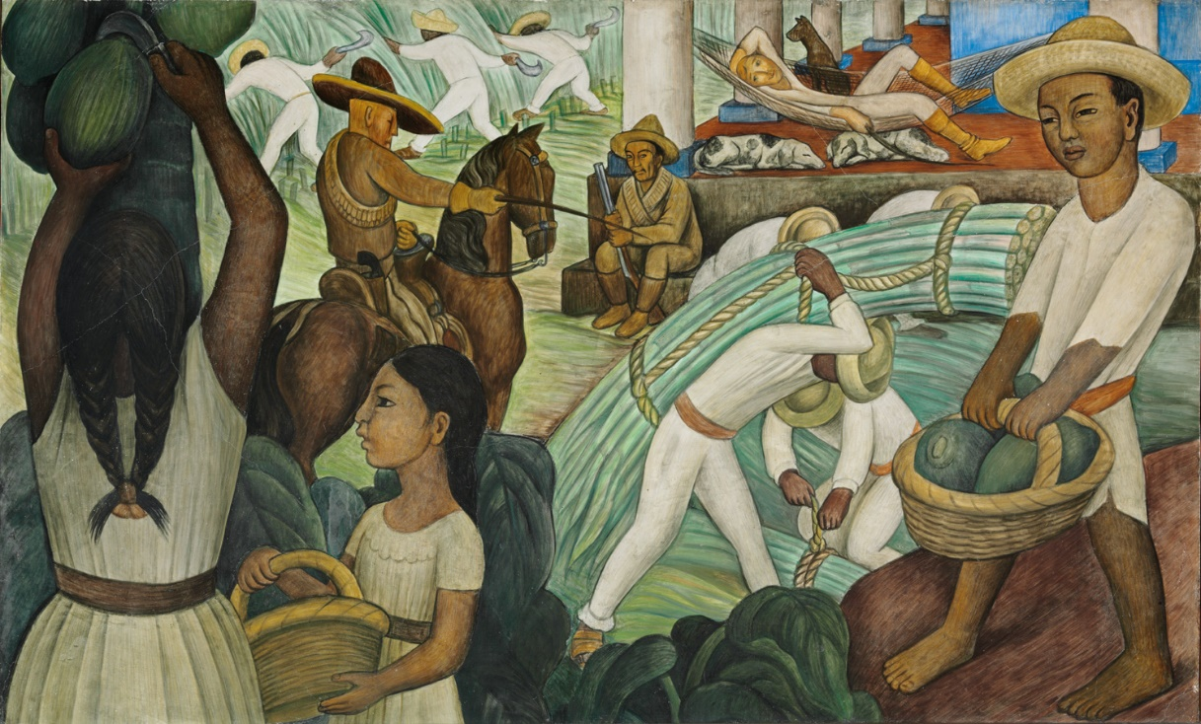
“State-Mandated and Market-Mediated Land Reform in Latin America” (Carter and Mesbah 2001)
Andre Gray

Slide 2
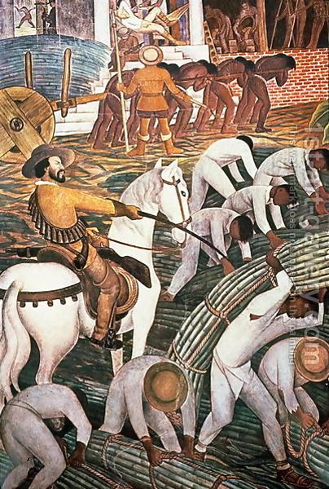
The Ideas
Land reform in Nicaragua, Peru and Ecuador offered beneficiaries gains to income, access to social services and economic security.
But reforms left out a large amount of rural poor. Why?
Scope: political costs, political will
Organizational Model: Collectivist vs Distributist Reform

Slide 3
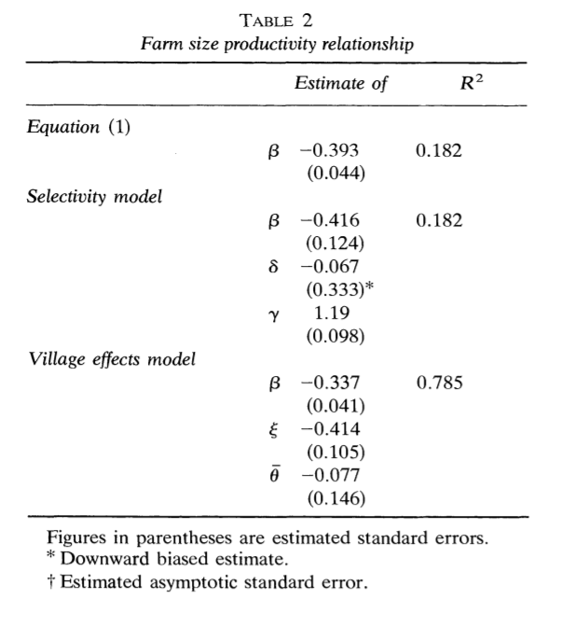
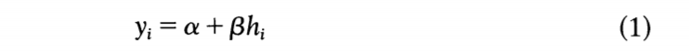
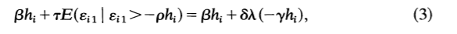
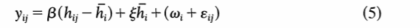
Motivating Distributist Land Reform
Inverse relationship between farm size and productivity (Carter 1984)
Management surveys taken in Indian state of Haryana 1960-1972

Slide 4
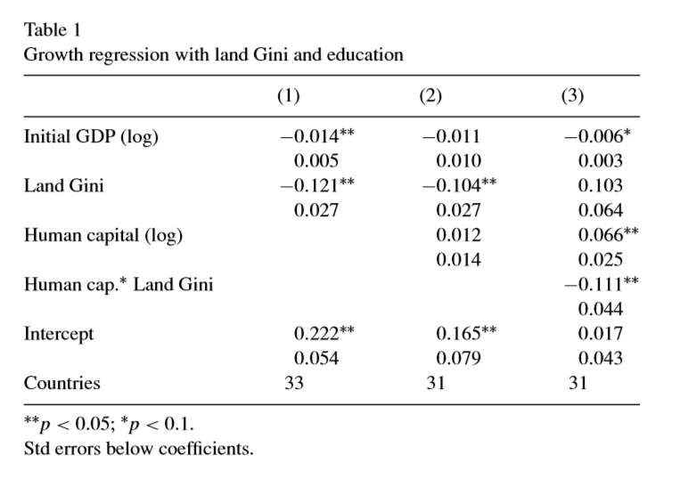
Land Inequality and Economic Growth
Theoretical link between inequality and growth better explained by asset inequality and not income inequality.
Extended political economy models with capital market imperfections include credit constraints that prevent the poor from undertaking profitable investments.
Through its impact on economic efficiency, the distribution of assets can affect the cost of market exchange, the incentives to invest, the levels of violence, and the societies’ ability to respond to exogenous shocks.

Slide 5

The Chicago Question
If there are strong Pareto-improving gains to be had by shifting land from large to small units, why is land reform necessary?
Feudal hypothesis
Land Market imperfections hypothesis
Price distortions hypothesis
Inadequate small-farm savings hypothesis
Countervailing capital constraints hypothesis

Slide 6
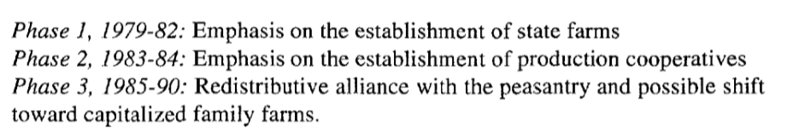
Nicaragua’s Land Reform Record
In 1971, 6% of rural households owned 63% of the land
Sandinista’s agricultural reform: focused on redistributing rights of access to ag labor, not land

Slide 7
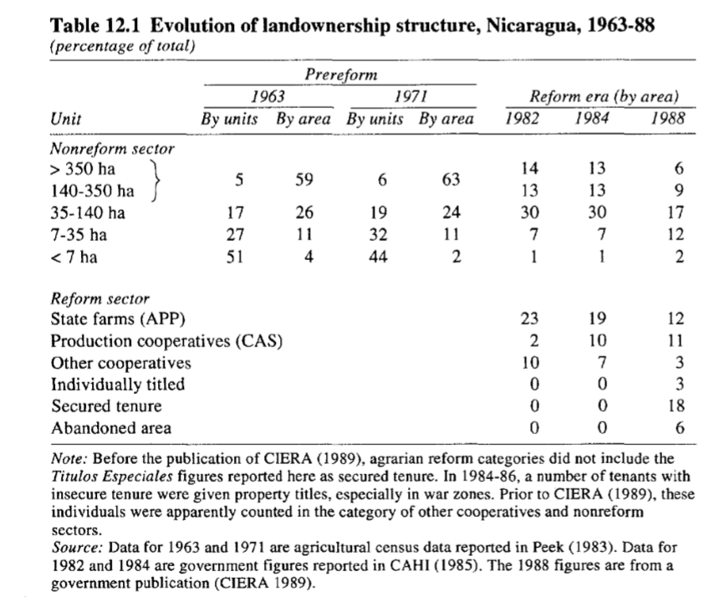

Slide 8
Phase 1 and 2 were great for provision of social services to rural populations (with help from international donations and soft loans).
Largely failed to provide secure wage employment—never employed more than 31,000 full-time workers on state farms (8% of rural workers).
Poor labor absorption meant the effect was minimal for rural poverty.

Slide 9
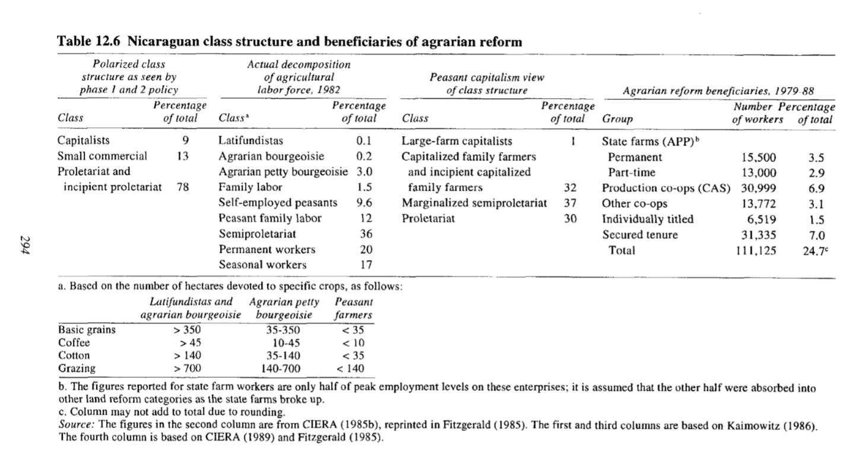

Slide 10
Constraints to Land Reform
Nicaraguan history of large-scale farming created a marginal, unproductive proletarianized rural society. Government felt little choice but to continue a large-farm agriculture model.
Constraints of mobilizing surplus from small-scale agriculture, small-scale sector incapable of buying out large-scale producers.
Limited decollectivization
“Microeconomic analysis built around insights on intrinsically and informationally imperfect labor and capital markets…may imply that holdings small enough to produce a significant effect on poverty are economically handicapped.”

Slide 11
Works Cited
“State-Mandated and Market-Mediated Land Reform in Latin America” (Carter and Mesbah 2001)
“Identification of the Inverse Relationship between Farm Size and Productivity: An Empirical Analysis of Peasant Agricultural Production” (Carter 1984)
“Land inequality and economic growth: a dynamic panel data approach” (Fort 2007)

